Slide 1
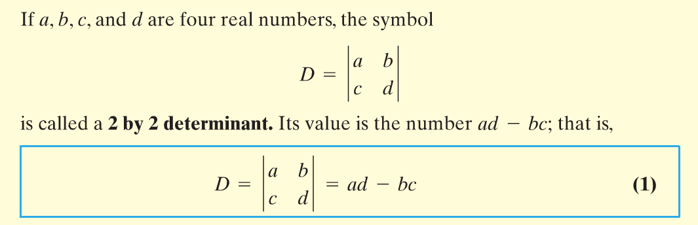


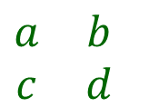

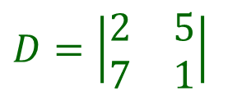
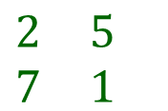
Section 8.3 – Systems of Linear Equations - Determinants
Using Determinants to Solve Systems of Equations
A determinant is a value that is obtained from a square matrix.
$$\begin{matrix}a & b \\ c & d\end{matrix}$$
$$\begin{matrix}2 & 5 \\ 7 & 1\end{matrix}$$
$$D=\left|\begin{matrix}2 & 5 \\ 7 & 1\end{matrix}\right|$$
$$=2∙1−5∙7$$
$$=2−35$$
$$=−33$$

Slide 2
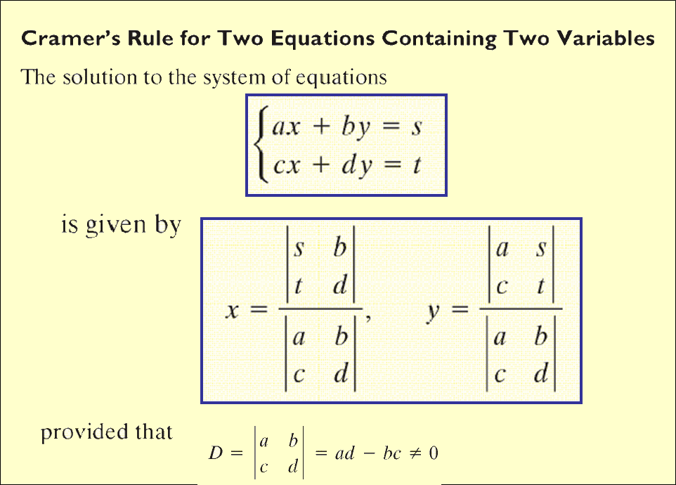






Section 8.3 – Systems of Linear Equations - Determinants
$$Determinant of x:$$
$$Determinant of y:$$
$$D_{x}$$
$$D_{y}$$
$$x=\frac{D_{x}}{D}$$
$$y=\frac{D_{y}}{D}$$

Slide 3
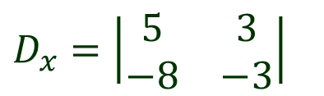


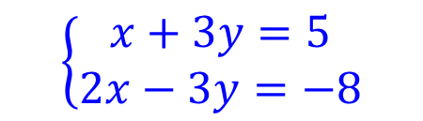


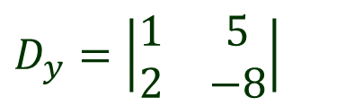
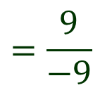
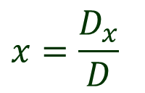
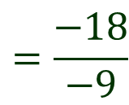





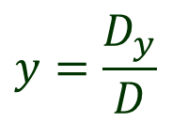
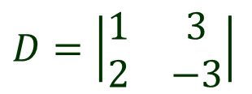


Section 8.3 – Systems of Linear Equations - Determinants
Using Determinants to Solve Systems of Equations. (pg. 579 #18)
$$\left\{\begin{matrix}x+3y=5 \\ 2x−3y=−8\end{matrix}\right.$$
$$D=\left|\begin{matrix}1 & 3 \\ 2 & −3\end{matrix}\right|$$
$$=1∙(−3)−3∙2$$
$$=−3−6$$
$$=−9$$
$$D_{x}=\left|\begin{matrix}5 & 3 \\ −8 & −3\end{matrix}\right|$$
$$=5∙(−3)−3∙(−8)$$
$$=−15+24$$
$$=9$$
$$D_{y}=\left|\begin{matrix}1 & 5 \\ 2 & −8\end{matrix}\right|$$
$$=1∙(−8)−5∙2$$
$$=−8−10$$
$$=−18$$
$$x=\frac{D_{x}}{D}$$
$$=\frac{9}{−9}$$
$$y=\frac{D_{y}}{D}$$
$$=\frac{−18}{−9}$$
$$=−1$$
$$=2$$
$$Solution:(−1, 2)$$

Slide 4
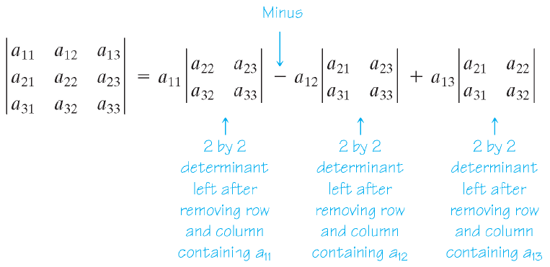




Section 8.3 – Systems of Linear Equations - Determinants
Using Determinants to Solve Systems of Equations
Determinant of a 3 x 3 Matrix
$$\left|\begin{matrix}a_{11} & a_{12} & a_{13} \\ a_{21} & a_{22} & a_{23} \\ a_{31} & a_{32} & a_{33}\end{matrix}\right|$$
$$\left|\begin{matrix}a_{11} & a_{12} & a_{13} \\ a_{21} & a_{22} & a_{23} \\ a_{31} & a_{32} & a_{33}\end{matrix}\right|$$
$$\left|\begin{matrix}a_{11} & a_{12} & a_{13} \\ a_{21} & a_{22} & a_{23} \\ a_{31} & a_{32} & a_{33}\end{matrix}\right|$$
$$\left|\begin{matrix}a_{11} & a_{12} & a_{13} \\ a_{21} & a_{22} & a_{23} \\ a_{31} & a_{32} & a_{33}\end{matrix}\right|$$

Slide 5


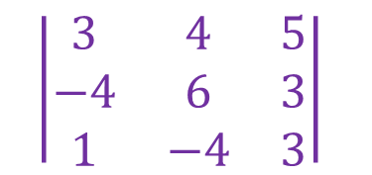
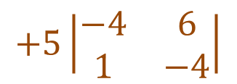

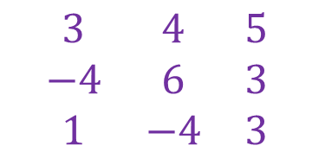
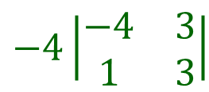

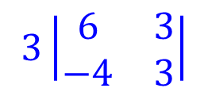



Section 8.3 – Systems of Linear Equations - Determinants
3 x 3 Determinants
Calculate the determinant of the given matrix.
$$\begin{matrix}3 & 4 & 5 \\ −4 & 6 & 3 \\ 1 & −4 & 3\end{matrix}$$
$$\left|\begin{matrix}3 & 4 & 5 \\ −4 & 6 & 3 \\ 1 & −4 & 3\end{matrix}\right|$$
$$D=$$
$$3\left|\begin{matrix}6 & 3 \\ −4 & 3\end{matrix}\right|$$
$$−4\left|\begin{matrix}−4 & 3 \\ 1 & 3\end{matrix}\right|$$
$$+5\left|\begin{matrix}−4 & 6 \\ 1 & −4\end{matrix}\right|$$
$$D=$$
$$3(6∙3−3∙\left(−4\right))$$
$$−4((−4)∙3−3∙1)$$
$$+5((−4)∙(−4)−6∙1)$$
$$D=90+60+50$$
$$D=200$$

Slide 6
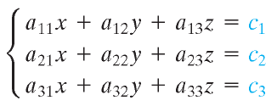
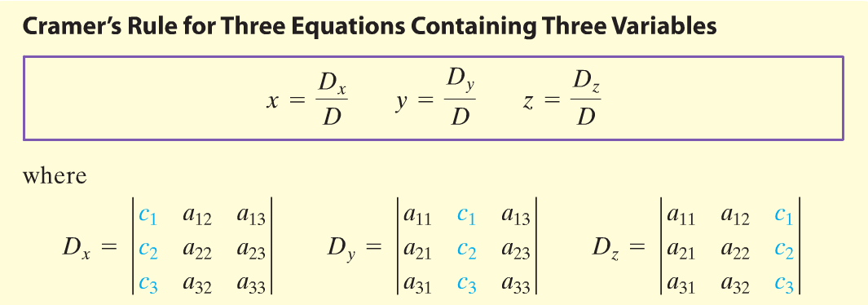

Section 8.3 – Systems of Linear Equations - Determinants
Using Determinants to Solve Systems of Equations
$$D≠0$$

Slide 7


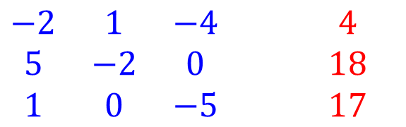



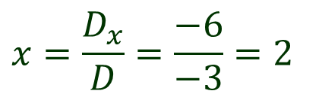








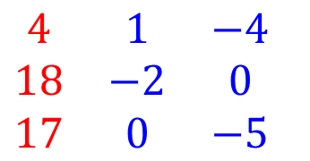
Section 8.3 – Systems of Linear Equations - Determinants
Using Determinants to Solve Systems of Equations
$$−2x+y−4z=4$$
$\begin{matrix}−2 & 1 & −4 \\ 5 & −2 & 0 \\ 1 & 0 & −5\end{matrix}$ $\begin{matrix}4 \\ 18 \\ 17\end{matrix}$
$$5x−2y=18$$
$$x−5z=17$$
$$D=$$
$$−2(−2∙−5−0∙0)$$
$$−1(5∙(−5)−0∙1)$$
$$+(−4)(5∙0−(−2)∙1)$$
$$D=−3$$
$\begin{matrix}4 & 1 & −4 \\ 18 & −2 & 0 \\ 17 & 0 & −5\end{matrix}$
$$D_{x}=$$
$$4(−2∙(−5)−0∙0)$$
$$−1(18∙(−5)−0∙17)$$
$$+(−4)(18∙0−(−2)∙17)$$
$$D_{x}=−6$$
$$x=\frac{D_{x}}{D}=\frac{−6}{−3}=2$$

Slide 8





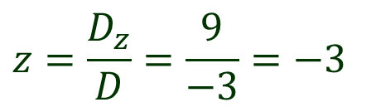
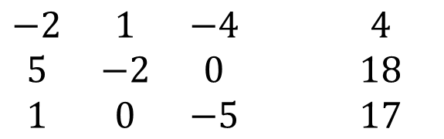


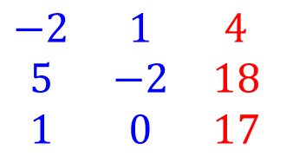


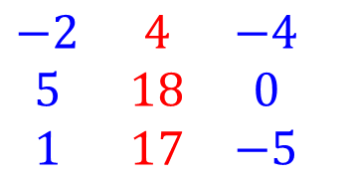

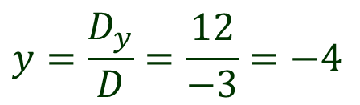

Section 8.3 – Systems of Linear Equations - Determinants
Using Determinants to Solve Systems of Equations
$\begin{matrix}−2 & 1 & −4 \\ 5 & −2 & 0 \\ 1 & 0 & −5\end{matrix}$ $\begin{matrix}4 \\ 18 \\ 17\end{matrix}$
$\begin{matrix}−2 & 4 & −4 \\ 5 & 18 & 0 \\ 1 & 17 & −5\end{matrix}$
$$D=−3$$
$$D_{y}=$$
$$−2(18∙(−5)−0∙17)$$
$$−4(5∙(−5)−0∙1)$$
$$+(−4)(5∙17−18∙1)$$
$$D_{y}=12$$
$$y=\frac{D_{y}}{D}=\frac{12}{−3}=−4$$
$\begin{matrix}−2 & 1 & 4 \\ 5 & −2 & 18 \\ 1 & 0 & 17\end{matrix}$
$$D_{z}=$$
$$−2((−2)∙17−18∙0)$$
$$−1(5∙17−18∙1)$$
$$+4(5∙0−(−2)∙1)$$
$$D_{z}=9$$
$$z=\frac{D_{z}}{D}=\frac{9}{−3}=−3$$

Slide 9
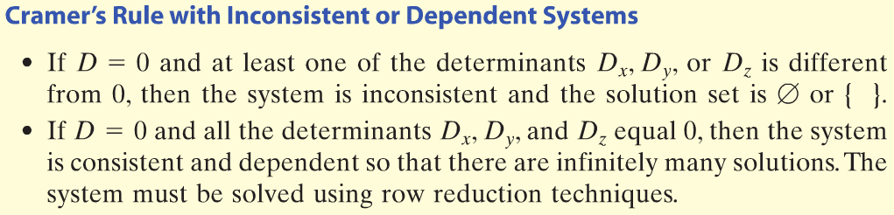


Section 8.3 – Systems of Linear Equations - Determinants
Using Determinants to Solve Systems of Equations
$$−2x+y−4z=4$$
$$5x−2y=18$$
$$Solution:$$
$$(2, −4, −3)$$
$$x−5z=17$$

Slide 10
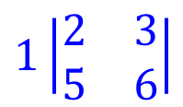




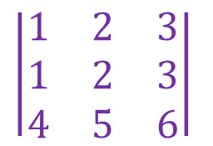


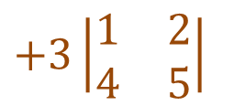
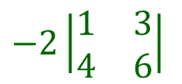

Section 8.3 – Systems of Linear Equations - Determinants
Properties of Determinants
$$\left|\begin{matrix}1 & 2 & 3 \\ 1 & 2 & 3 \\ 4 & 5 & 6\end{matrix}\right|$$
$$D=$$
$$1\left|\begin{matrix}2 & 3 \\ 5 & 6\end{matrix}\right|$$
$$−2\left|\begin{matrix}1 & 3 \\ 4 & 6\end{matrix}\right|$$
$$+3\left|\begin{matrix}1 & 2 \\ 4 & 5\end{matrix}\right|$$
$$D=$$
$$1(2∙6−3∙5)$$
$$−2(1∙6−3∙4)$$
$$+3(1∙5−2∙4)$$
$$=−3+12−9$$
$$=0$$

Slide 11
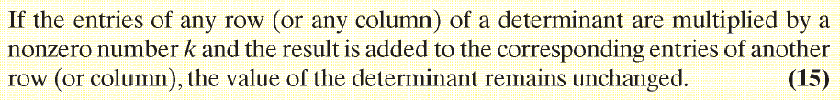

Section 8.3 – Systems of Linear Equations - Determinants
Properties of Determinants
$$R_{1}→{−2r}_{2}+r_{1}$$

Slide 12




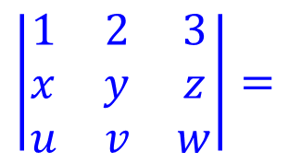
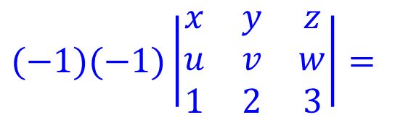
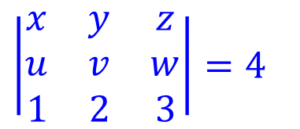



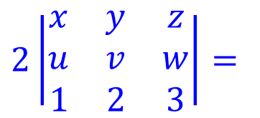
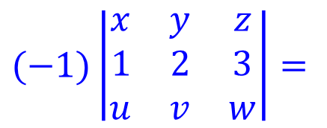

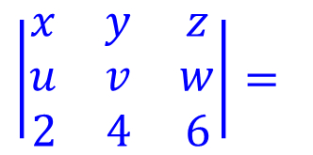
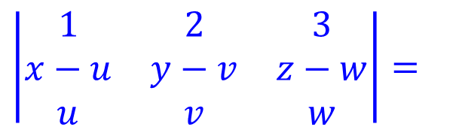

Section 8.3 – Systems of Linear Equations - Determinants
Use the properties of determinants to solve the following problems.
$$\left|\begin{matrix}x & y & z \\ u & v & w \\ 1 & 2 & 3\end{matrix}\right|=4$$
$$Pg. 579 \#44$$
$$\left|\begin{matrix}x & y & z \\ u & v & w \\ 2 & 4 & 6\end{matrix}\right|=$$
$$2\left|\begin{matrix}x & y & z \\ u & v & w \\ 1 & 2 & 3\end{matrix}\right|=$$
$$2(4)=$$
$$8$$
$$Pg. 579 \#46$$
$$\left|\begin{matrix}1 & 2 & 3 \\ x−u & y−v & z−w \\ u & v & w\end{matrix}\right|=$$
$$\left|\begin{matrix}1 & 2 & 3 \\ x & y & z \\ u & v & w\end{matrix}\right|=$$
$$(−1)\left|\begin{matrix}x & y & z \\ 1 & 2 & 3 \\ u & v & w\end{matrix}\right|=$$
$$R_{2}→r_{2}+r_{3}$$
$$R_{1}↔R_{2}$$
$$R_{2}↔R_{3}$$
$$(−1)(−1)\left|\begin{matrix}x & y & z \\ u & v & w \\ 1 & 2 & 3\end{matrix}\right|=$$
$$4$$
$$\left(−1\right)\left(−1\right)4=$$

